Slide 1


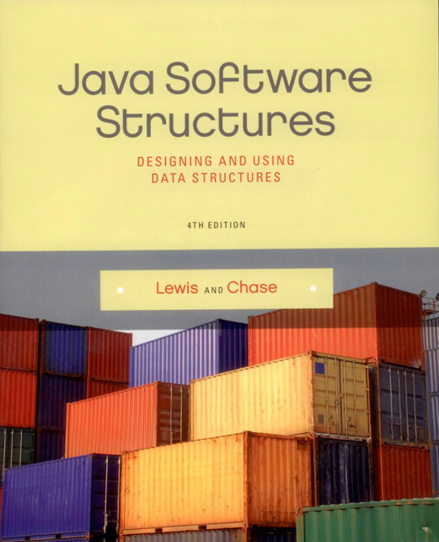
INTRODUCTION TO
COLLECTIONS
Stack

Slide 2
Chapter Scope
Collection terminology
The Java Collections API
Abstract nature of collections
Stacks
Conceptually
Used to solve problems
Implementation using arrays
Visit this link:
4.9. Dynamic Array-Based Stacks — Data Structures and Algorithms (chalmersgu-data-structure-courses.github.io)

Slide 3
Collection
A collection is an object that holds and organizes other objects.
It provides operations for accessing and managing its elements.
Many standard collections have been defined over time.
Some collections are linear in nature, others are non-linear.

Slide 4
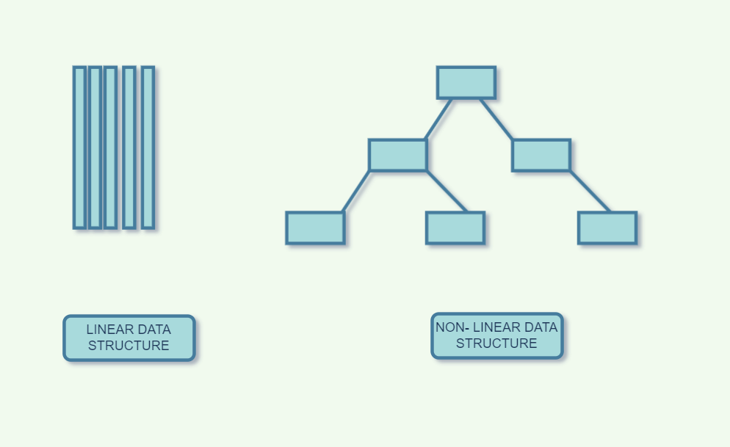
Linear and Non-Linear Collections

Slide 5
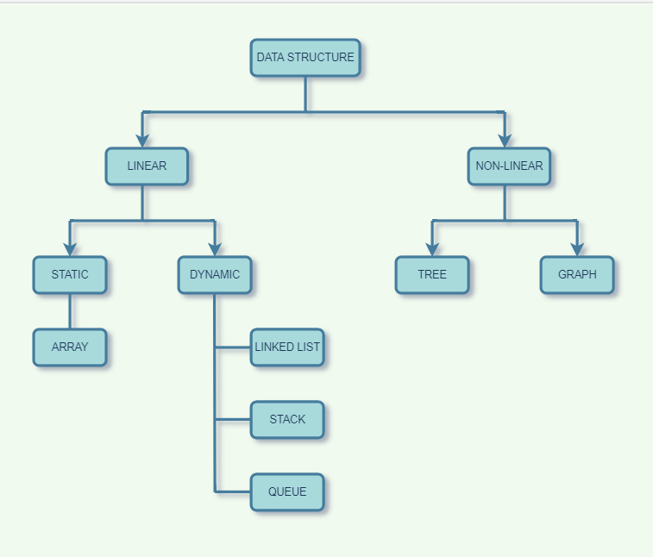

Slide 6
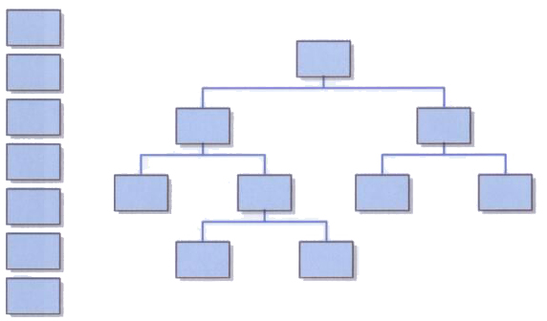
Linear and Non-Linear Collections
The organization of the elements in a collection is usually determined by:
The order in which they were added to the collection.
Some inherent relationship among the elements themselves.

Slide 7
Abstraction
An abstraction hides details to make a concept easier to manage.
All objects are abstractions in that they provide well-defined operations (the interface).
They hide (encapsulate) the object's data and the implementation of the operations.
An object is a great mechanism for implementing a collection.

Slide 8
Abstract Data Type
A data type is a group of values and the operations defined on those values (e.g.: int).
An abstract data type (ADT) is a data type that isn't pre-defined in the programming language.
A data structure is the set of programming constructs and techniques used to implement a collection.
The distinction between the terms ADT, data structure, and collection is sometimes blurred in casual use.

Slide 9
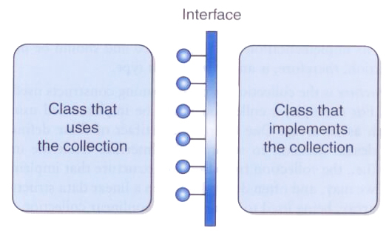
Collection Abstraction
A class that uses a collection interacts with it through a particular interface.

Slide 10
Java Collections API
As you know, the various classes provided with Java are referred to as the Java API (application programmer interface).
The subset of those classes that support collections is called the Java Collections API.
As we explore a particular collection, we will also examine any support provided in the Collections API for that collection.

Slide 11
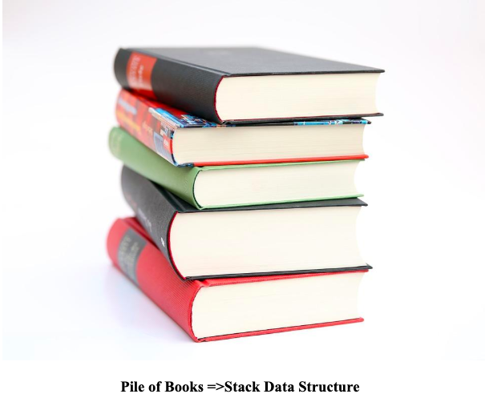
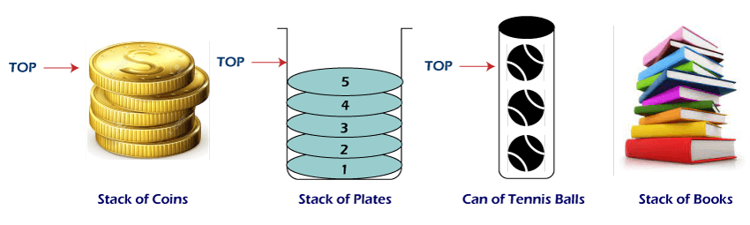
Stacks

Slide 12
Stack
A stack is a classic collection used to help solve many types of problems.
A stack is a linear collection whose elements are added in a last in, first out (LIFO) manner.
That is, the last element to be put on a stack is the first one to be removed.
Think of a stack of books, where you add and remove from the top, but can't reach into the middle.

Slide 13
Some Stacks Applications
Reverse the order of something: undo operation
Function calls Tracing.
Compiler syntax checking ({})
Keeping history of visited sites (navigation).
HTML Tags matching .

Slide 14
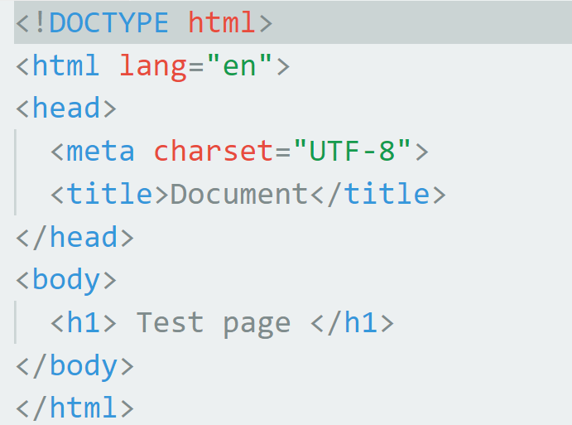
HTML Tags matching .

Slide 15
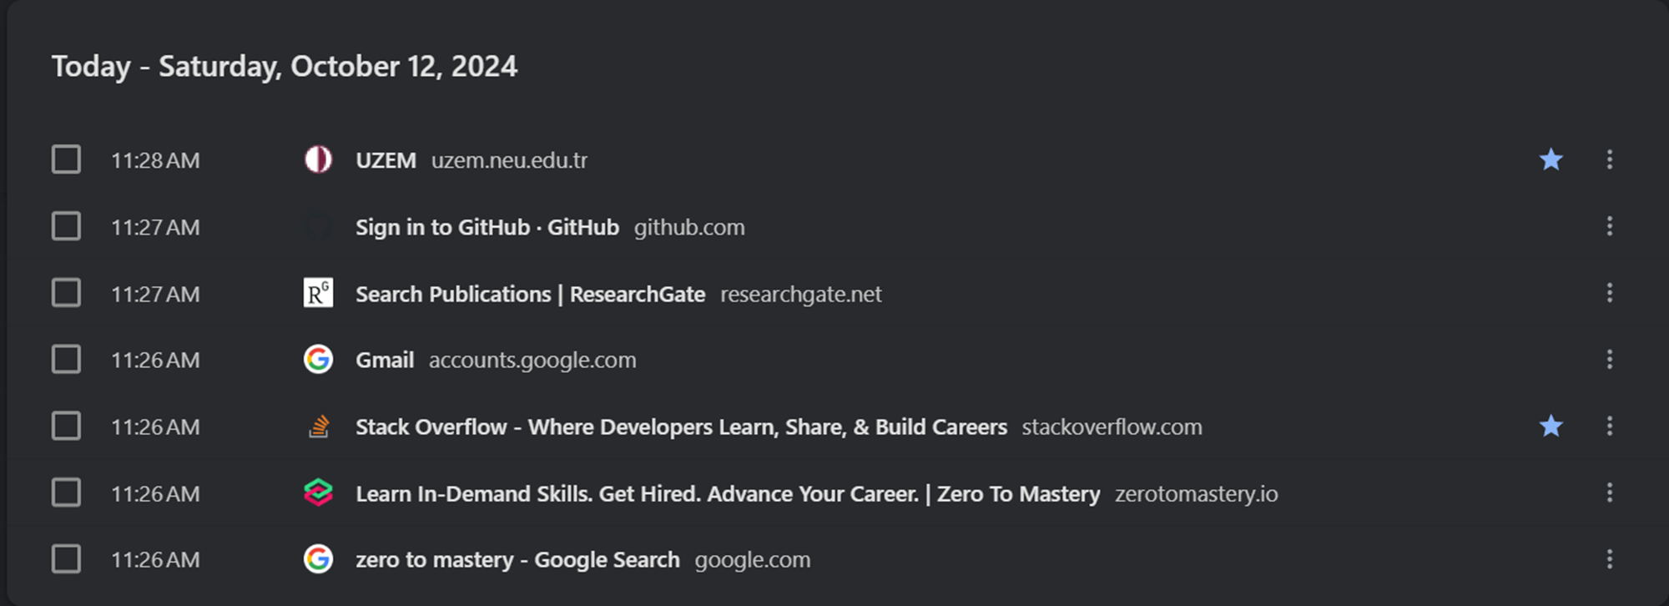
Keeping history of visited sites (navigation).

Slide 16
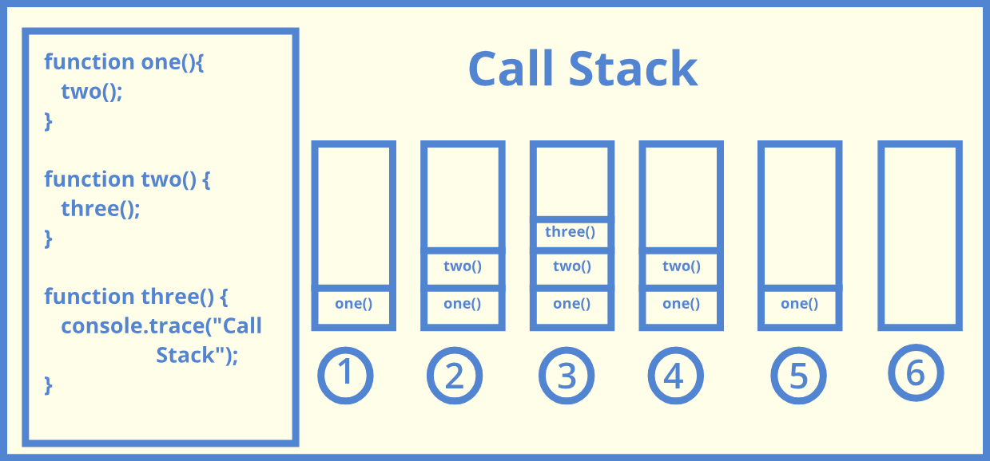
Function calls Tracing.

Slide 17
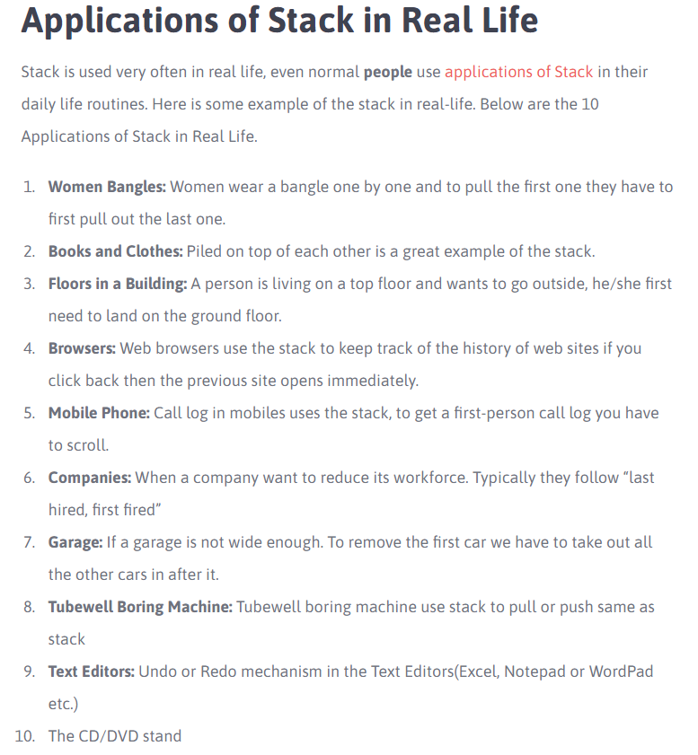
Stacks Applications
In Real Life

Slide 18
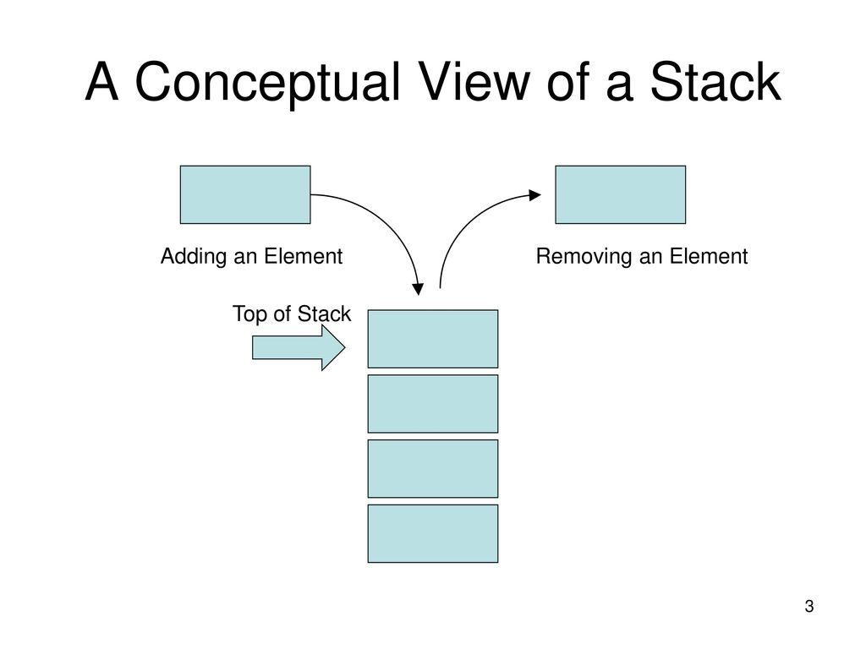

Slide 19
Stack Operations
Operation | Description
Push() | Adds an element to the top of the stack.
Pop() | Removes an element from the top pf the stack.
Peek() | Examines the element at the top of the stack.
IsEmpty() | Determines if the stack is Empty.
Size() | Determines the number of elements on the stack.

Slide 21

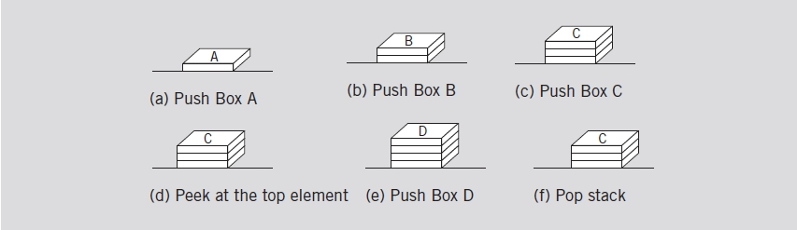
Stacks (cont’d.)
Empty stack
Stack operations
Notes:
https://www.cs.usfca.edu/~galles/visualization/StackArray.html

Slide 22
Object-Oriented Concepts
Several OO concepts, new and old, will be brought to bear as we explore collections.
We'll rely on type compatibility rules, interfaces, inheritance, and polymorphism.
Review these concepts as necessary.
We'll also rely on a programming mechanism introduced in Java 5, generics, which are particularly appropriate for implementing collections.

Slide 23
Generics
Suppose we define a stack that holds Object references, which would allow it to hold any object.
But then we lose control over which types of elements are added to the stack, and we'd have to cast elements to their proper type when removed.
A better solution is to define a class that is based on a generic type.
The type is referred to generically in the class, and the specific type is specified only when an object of that class is created.

Slide 24
Generics
The generic type placeholder is specified in angle brackets in the class header:
class Box<T>
{
// declarations and code that refer to T
}
Any identifier can be used, but T (for Type) or E (for element) have become standard practice.

Slide 25
Generics
Then, when a Box is needed, it is instantiated with a specific class instead of T:
Box<Widget> box1 = new Box<Widget>();
Now, box1 can only hold Widget objects.
The compiler will issue errors if we try to add a non-Widget to the box.
And when an object is removed from the box, it is assumed to be a Widget.

Slide 26
Generics
Using the same class, another object can be instantiated:
Box<Gadget> box2 = new Box<Gadget>();
The box2 object can only hold Gadget objects.
Generics provide better type management control at compile-time and simplify the use of collection classes.

Slide 27
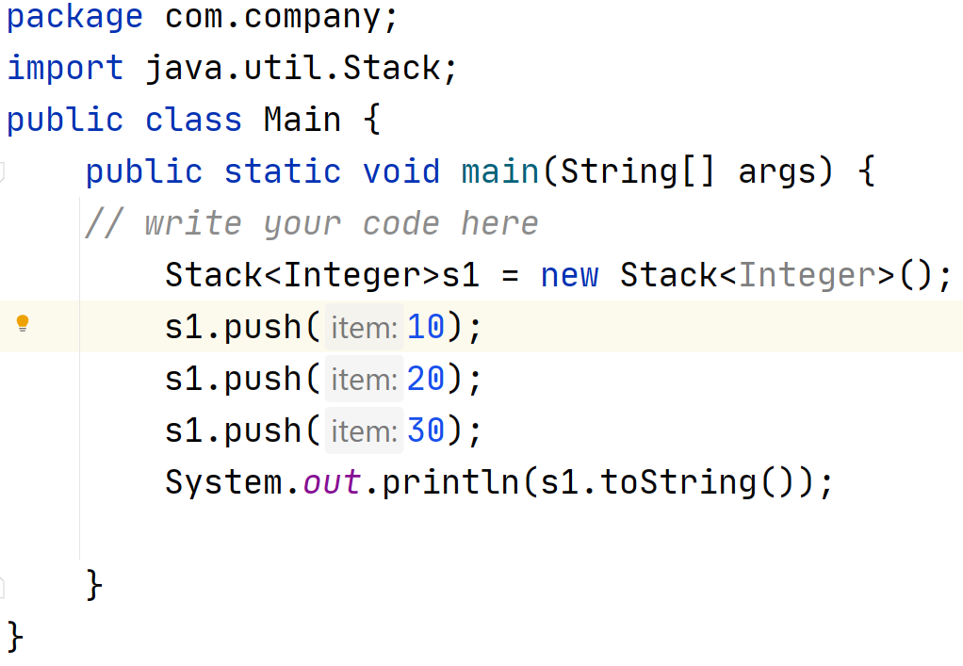
Stacks-Example 1
Stack Animation: https://liveexample.pearsoncmg.com/dsanimation13ejava/StackeBook.html

Slide 28
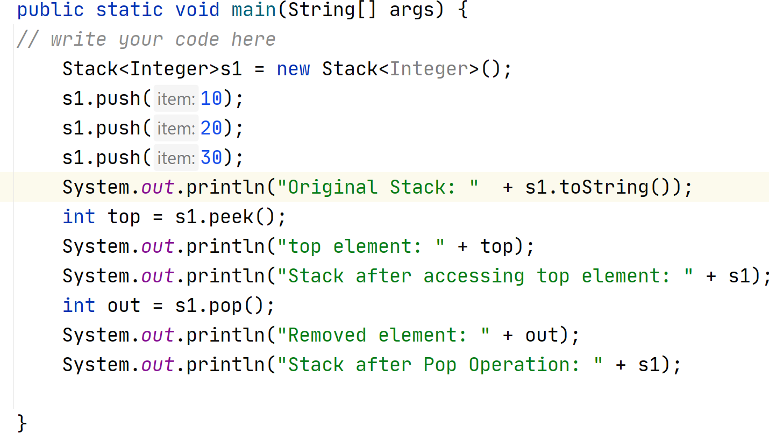
Stacks-Example 2

Slide 29
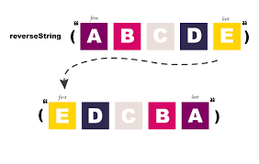
Application: Reversing a String
Input: “ABCDE”
Output: “EDCBA”
How?

Slide 30
Reverse a String using stack
We can use the property of stack data structure to reverse a string. Here are the algorithm –
First we have to push all the characters of a string in a stack. Once all the characters are pushed the next step is to pop the characters from a stack.
Input : JAVA
When we do the pop operation, first A is popped out then V,A,J.
Output: AVAJ
top
A
V
A
J

Slide 31
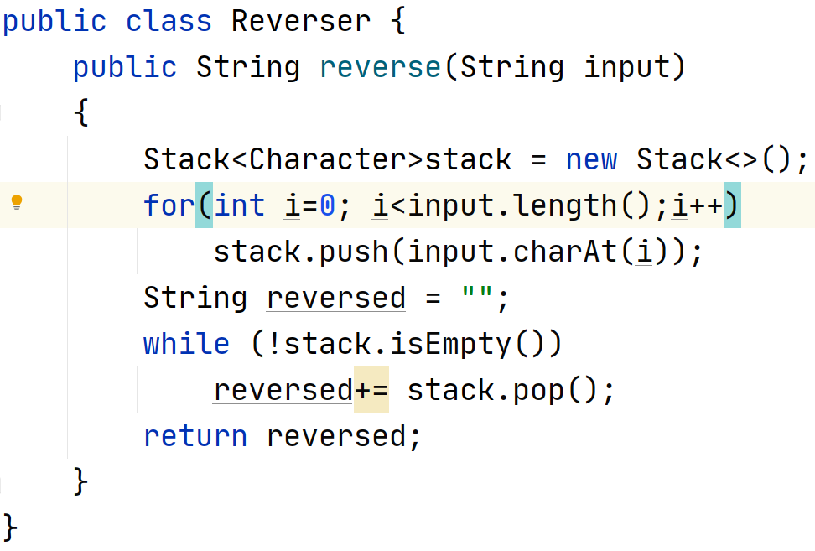
Application: Reversing a String Solution:

Slide 32
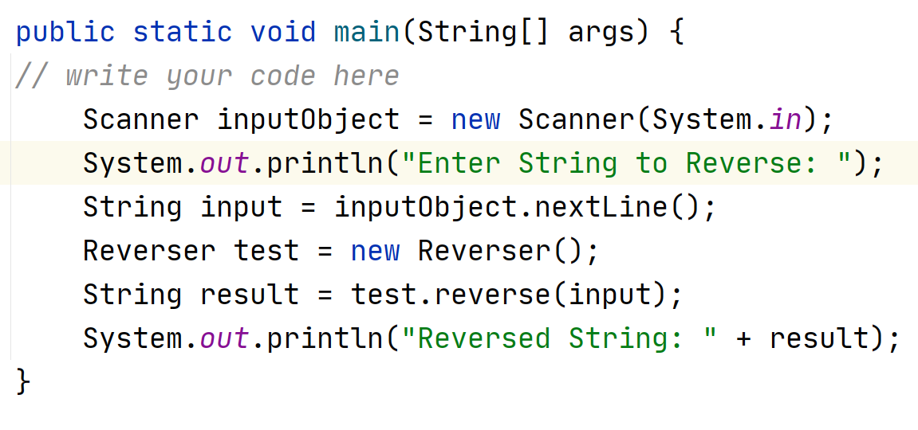
Application: Reversing a String Testing:

Slide 33
Application: Reversing a String
The previous solution works well, but there is a lot of string concatenation (reversed+=stack.pop()).
Imagine if the string input is long:
Every time it is run, a new string object is created in memory because strings are immutable in Java.

Slide 34
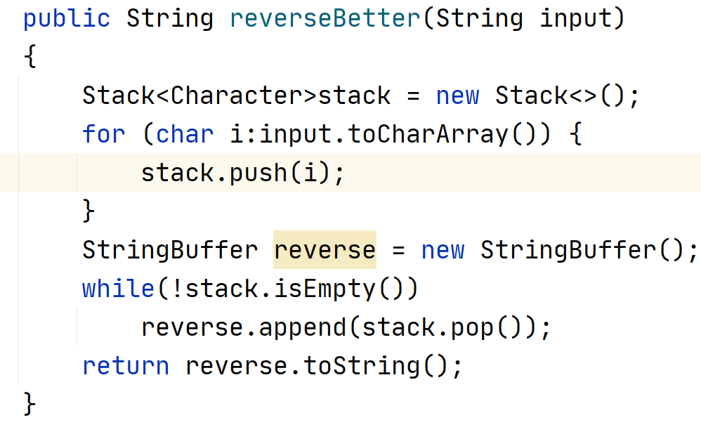
Application: Reversing a String A better Solution:

Slide 35
Exceptions
An exception is an object that defines an unusual or erroneous situation.
An exception is thrown by a program or the run-time environment, and it can be caught and handled appropriately if desired.
Several potential exceptions for Stacks:
If the stack is full on a push.
If the stack is empty on a pop.

Slide 36
Exceptions
When should exceptions be thrown from a collection class?
Only when a problem is specific to the concept of the collection (not its implementation or its use)
There's no need for the user of a collection to worry about it getting "full," so we'll take care of any such limitations internally.
But a stack should throw an exception if the user attempts to pop an empty stack.

Slide 37
Representation of Stack
There are two ways to implement Stack:
the first one is using array ,
and the other one is using a Linked list.

Slide 38
Implementing a Stack with an Array
1
ARRAY STACK

Slide 39
Implementing a Stack with an Array
Let's now explore our own implementation of a stack, using an array as the underlying structure in which we'll store the stack elements.
We'll have to take into account the possibility that the array could become full.
And remember that an array of objects really stores references to those objects.

Slide 40
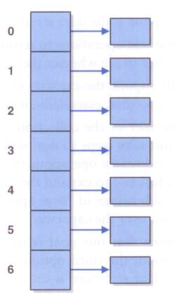
Implementing Stacks with an Array
An array of object references:

Slide 41
Managing Capacity
When an array object is created, it is allocated a specific number of cells into which elements can be stored.
Object[] collection = Object[500]; // stored at 0-499
Arrays are fixed-size data structure.
What to do if a new element is added to a full stack?
Throw an exception
Return a status indicator showing if the addition was successful.
Automatically expand the capacity of the array (the array would never become full).

Slide 42
Managing Capacity
The number of cells in an array is called its capacity.
It's not possible to change the capacity of an array in Java once it's been created.
Arrays are fixed-size data structure.
Therefore, to expand the capacity of the stack, we'll create a new (larger) array and copy over the elements.
This will happen infrequently, and the user of the stack need not worry about it happening.

Slide 43
Implementing Stacks with an Array
By convention, collection class names indicate the underlying structure:
So ours will be called ArrayStack
java.util.Stack is an exception to this convention
Assumptions:
The array is an array of object references (type determined when the stack is instantiated).
Our solution will keep the bottom of the stack fixed at index 0 of the array.
A separate integer called top will indicate where the top of the stack is, as well as how many elements are in the stack currently.

Slide 44
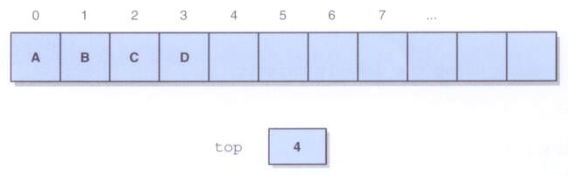
Implementing a Stack with an Array
A stack with elements A, B, C, and D pushed on in that order:

Slide 45
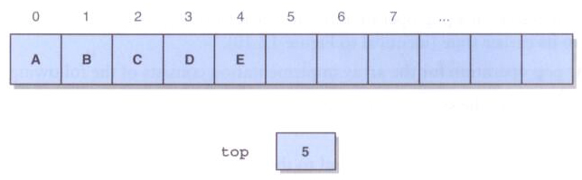
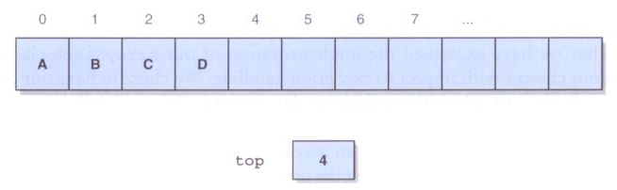
Pushing and Popping a Stack
After pushing element E:
After popping:

Slide 46
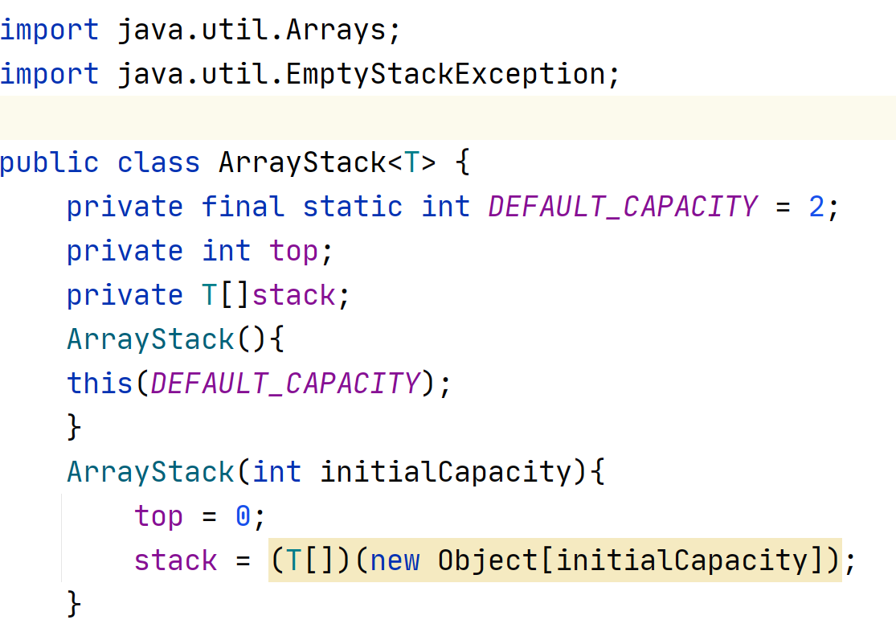
Constant variable
Creates an empty stack using the default capacity.
Creates an empty stack using the specified capacity.

Slide 47
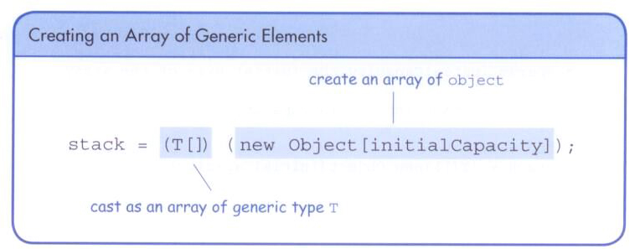
Creating an Array of a Generic Type
You cannot instantiate an array of a generic type directly.
Instead, create an array of Object references and cast them to the generic type.

Slide 48
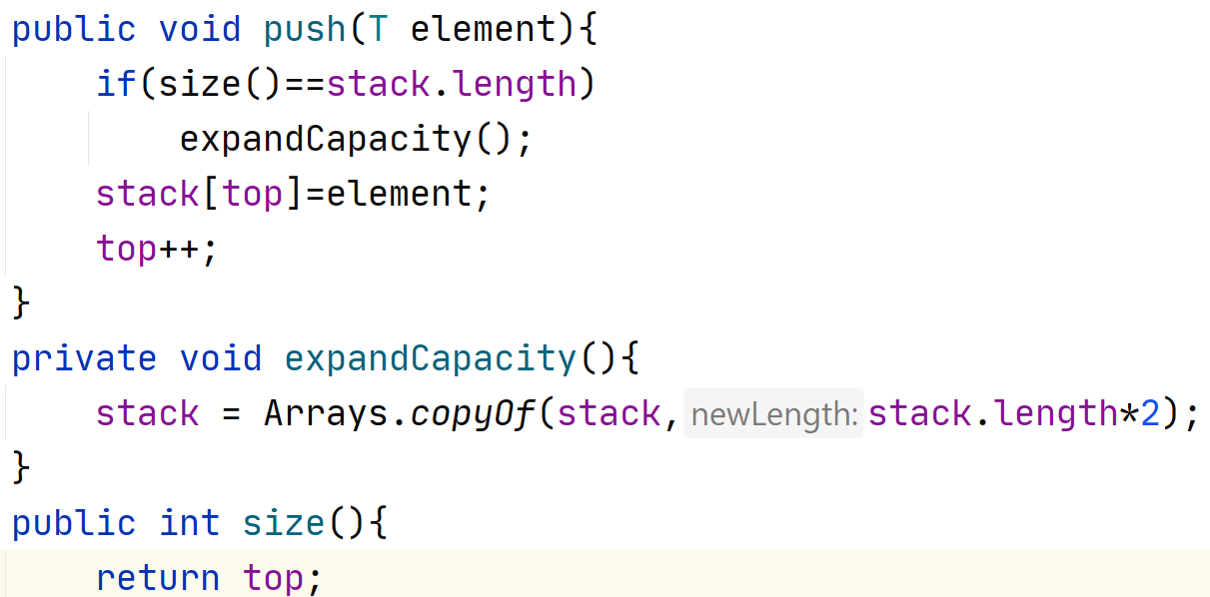
Adds the specified element to the top of the stack, expanding
the capacity of the stack array if necessary.
Creates a new array to store the contents of the stack with twice the capacity of the old one.
Returns the number of elements in the stack.

Slide 49
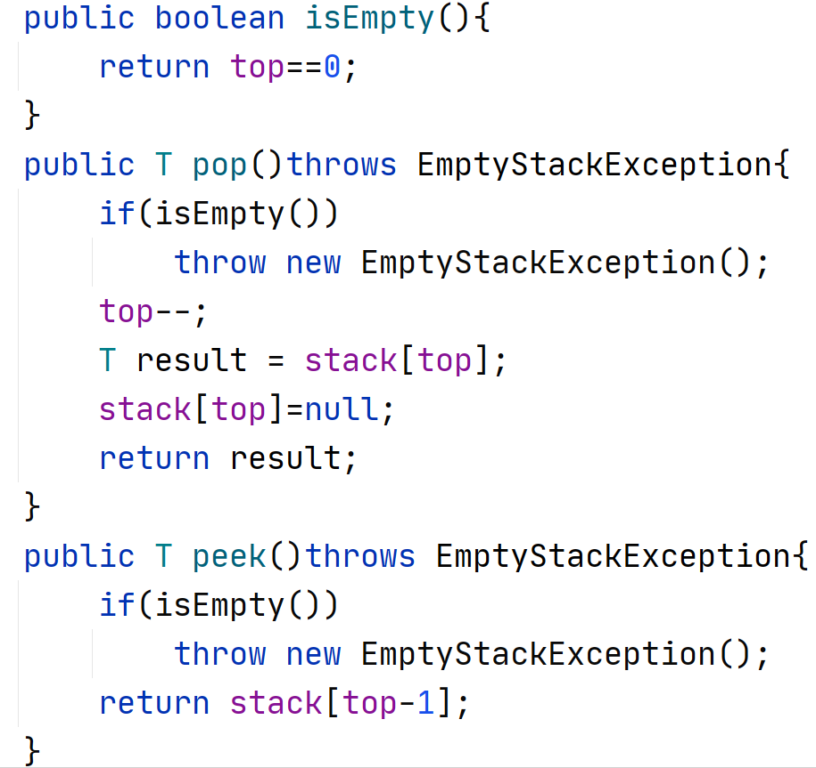
Returns true if the stack is empty and false otherwise.
Removes the element at the top of the stack and returns a reference to it. Throws an EmptyStackException if the stack is empty.
Returns a reference to the element at the top of the stack.
The element is not removed from the stack. Throws an EmptyStackException if the stack is empty.

Slide 50
Defining an Exception
An EmptyCollectionException is thrown when a pop or a peek is attempted and the stack is empty.
The EmptyCollectionException is defined to extend RuntimeException.
By passing a string into its constructor, this exception can be used for other collections as well.

Slide 51
/**
* Represents the situation in which a collection is empty.
*
* @author Lewis and Chase
* @version 4.0
*/
public class EmptyCollectionException extends RuntimeException
{
/**
* Sets up this exception with an appropriate message.
* @param collection the name of the collection
*/
public EmptyCollectionException(String collection)
{
super("The " + collection + " is empty.");
}
}

Slide 52
Stack Animation – visit the links below
https://yongdanielliang.github.io/animation/web/Stack.html
https://miro.medium.com/max/800/1*kkK3EZNOzBsuwkDNvSVR9g.gif
https://www.cs.usfca.edu/~galles/visualization/QueueArray.html
https://visualgo.net/en
4.9. Dynamic Array-Based Stacks — Data Structures and Algorithms (chalmersgu-data-structure-courses.github.io)

Slide 53
END

